Slide 1
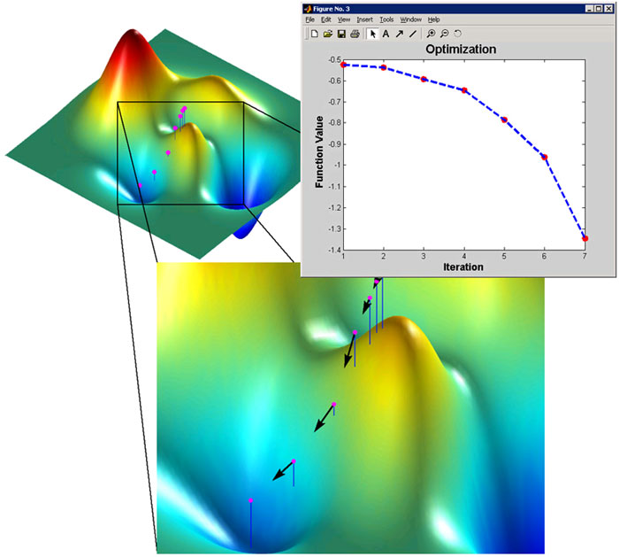
Optimization III

Slide 2
Administration: Final Exam
Date: June 7, 10:10—12:00
Coverage
Lecture notes: Chap5 (Chap5_2 & Chap5-3), Chapter 6, and Chapter 7
Supplemental material: Shewchuk’s paper
Textbook: chapter 5 and 6 (excluding numerical differentiation and materials not covered in lectures)

Slide 3
Summary of Conjugate Gradients
For a symmetric positive definite matrix A, CG guarantees to find the minimum of a quadratic objective function f(x)= x^{T}Ax-x^{T}b+c in n steps
The minimum x* is also the solution to linear system Ax = b

Slide 4
Conjugate Gradient Method
First iteration
Loop through

Slide 5
Conjugate Method on Least Square
CG can be used to solve the least square problem
M=A^{T}A is symmetric and positive definite, we can solve using CG

Slide 6
Nonlinear Conjugate Gradient Method
First iteration
Loop through

Slide 7
Nonlinear Conjugate Gradient (cont.)
Residual is now replaced by -▽f
r = b – Ax = - ▽f in quadratic form is a special case
For a nonlinear f, we need to compute - ▽f
Line search is more complicated now
There are multiple choices for β (see page 42 of Shewchuk’s paper)

Slide 8
Line search in Nonlinear CG
Finding zeros of
This is exactly a root-finding problem!
Newton method
Secant method

Slide 9
Line search using Newton’s method
Hessian of f

Slide 10
Line search using Secant method

Slide 11
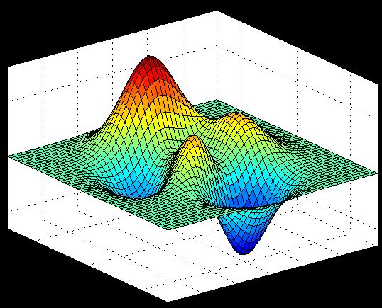
Example: Peaks function
f(x,y) = 3*(1-x)^2*exp(-(x^2) - (y+1)^2) - 10*(x/5 - x^3 - y^5)*exp(-x^2-y^2) - 1/3*exp(-(x+1)^2 - y^2)
http://www.cs.illinois.edu/~heath/iem/optimization/ConjugateGradient/

Slide 12
Initial Condition determines which minimum would be found
Starting from [-1, 0]
x* = [-1.3474, 0.2045]’
Starting from [0, -1]
x* = [0.2283, -1.6255]’

Slide 13
Matlab Optimization Toolbox
Unconstraint multidimensional optimization without knowing gradient and hessian functions
options = optimset('GradObj','off', 'Hessian','off', …,
'TolX', 1e-6, 'TolFun', 1e-6, 'Display', 'Iter');
[x,FVAL,EXITFLAG,OUTPUT] = fminunc(@myfun, x0, options);
f = myfun(x)

Slide 14
Matlab Optimization Toolbox
Unconstraint multidimensional optimization with known gradient and hessian function
options = optimset('GradObj','on', 'Hessian','on', …,
'TolX', 1e-6, 'TolFun', 1e-6, 'Display', 'Iter');
[x,FVAL,EXITFLAG,OUTPUT] = fminunc(@myfun, x0, options);
[f, g, H] = myfun(x)

